Slide 1

JS
FS dev 101
Datatypes
Copy By Val & Ref

Slide 2
Recap
var m1 = 10;
m1 = 20;
console.log(m1);
10
20
IDK

Slide 3
Recap
function f()
{
var m1 = 10;
var m2 = "10";
if(m1===m2)
{
console.log("Equal");
}
else
{
console.log("Not Equal");
}
}
function f()
{
var m1 = 10;
var m2 = "10";
if(m1==m2)
{
console.log("Equal");
}
else
{
console.log("Not Equal");
}
}
function f()
{
var m1 = 10;
var m2 = 10;
if(m1==m2)
{
console.log("Equal");
}
else
{
console.log("Not Equal");
}
}

Slide 4
Recap
var m1 = 10;
var m2 = 10;
If(m1==m1)
{
console.log(“Equal”);
};
else
{
console.log(“Not Equal”);
};

Slide 5
Data types
Primitive
(3)
Trivial
(2)
Composite
(3)
Numbers – BigInt – Boolean – Strings
null
undefined
Objects
10 / 10.5
true/false
“Hello GUVI”
let age = null;
let x;
alert(x); // shows "undefined"
{1:”GUVI”}
[10,30,20]
function f(){}
let n = 123;
let n1 = 12.345;
let name = "John";
let dstring1= "Hello";
let sstring2 = 'Single quotes are ok too';
let bstring3= `Backticks my str`;
let bvar1= true;
let bvar2= false;
let isGreater = 4 > 1;

Slide 6
Copy by value and Copy by reference
var a = 10
var b = a;
b = 20
console.log(a);
console.log(b);
a
10
b
20

Slide 7
Copy by value and Copy by reference
var a = 10
var b = a;
b = 20
console.log(a);
console.log(b);
var arr = ['a', 'b', 'c'];
var arr2 = arr;
arr2[2] = ‘r'
console.log(arr);
console.log(arr2);
arr → Array(3) [ "a", "b", "r" ]
All objects are copied by reference

Slide 8
arr
a, b ,c
arr2

Slide 9
Window object & Document Object
The Window interface represents a window containing a DOM document
A global variable, window, representing the window in which the script is running, is exposed to JavaScript code
window.document
Window.localStorage
Window.location
Window.name
Window.sessionStorage

Slide 10
Blog -writeup
Use typeof in all the datatypes and check the result
typeof(1)
typeof(1.1)
typeof("1.1")
typeof(true)
typeof(null)
typeof(undefined)
typeof([])
typeof({})
Write a blog about objects and its internal representation in Javascript

Slide 11
JS
FS dev 101
Objects in Javascript

Slide 12
Object Internals – Array is also an JSON object
Everything is JSON object except primitives
A Javascript Array is exclusively numerically indexed
Javascript arrays cannot have "string indexes“
When you set a "string index", you're setting a property of the object
Those properties are not part of the "data storage" of the array.
Checkout what's in the prototype property

Slide 13
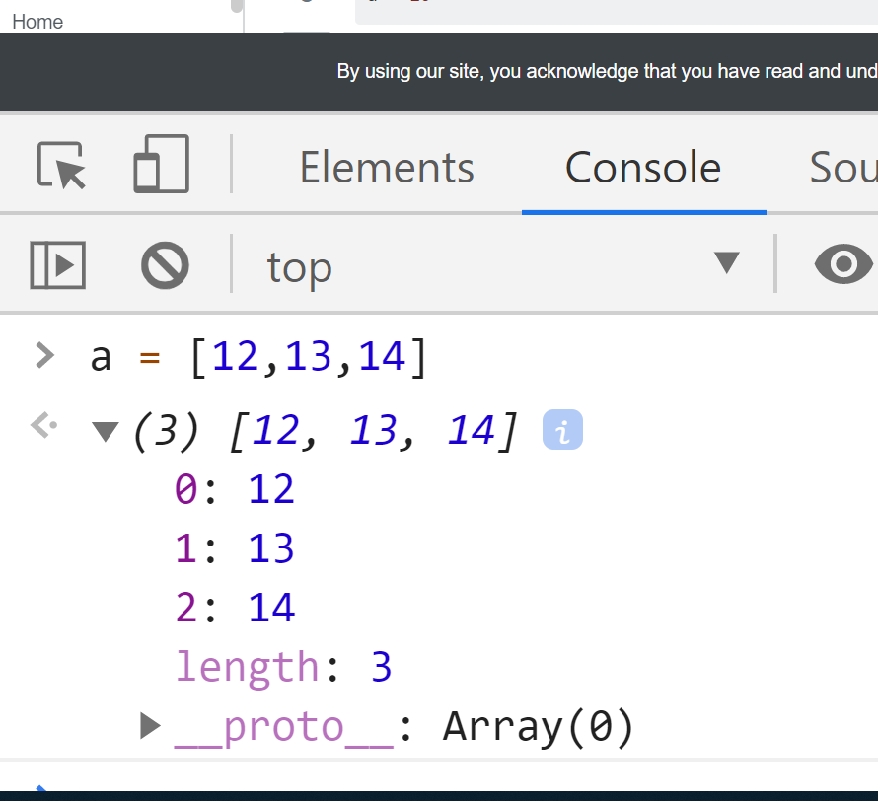

Slide 14
Key : Value → JSON(String) / JSON Objects
a = {
"foo" : "fighter",
"bar" : [1,2,3]
}
console.log(a["bar"]);
console.log(a.bar);
console.log(a.ttt);
console.log(a.ttt.tt);
Key or property or field or attribute or member_variable

Slide 15
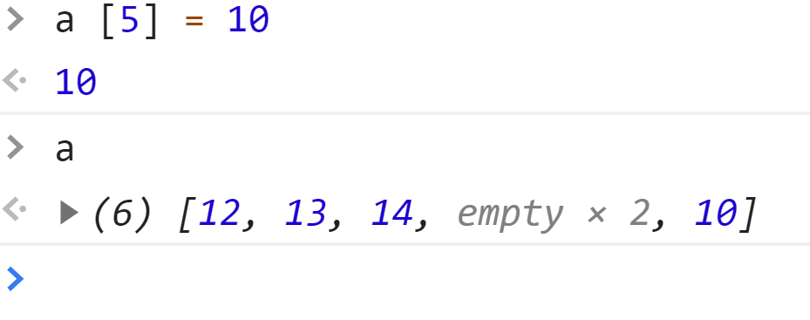
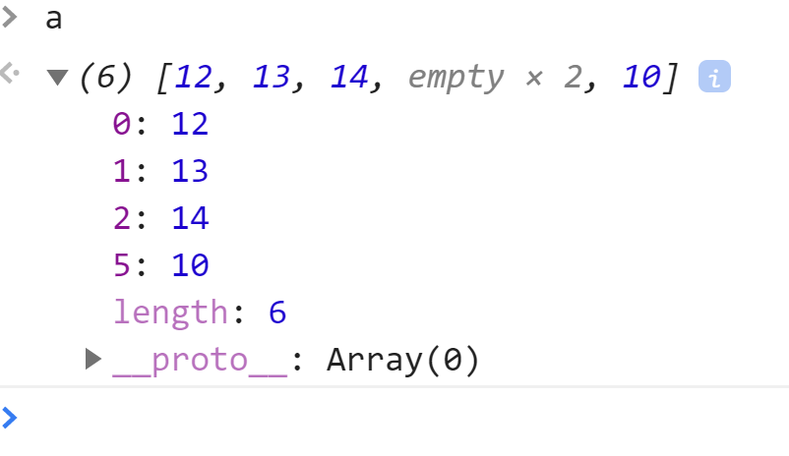
Creates an empty slot and fills it with undefined
Key: value pair
length is a property which has the element counts but it is not counted ( since it’s a property)

Slide 16
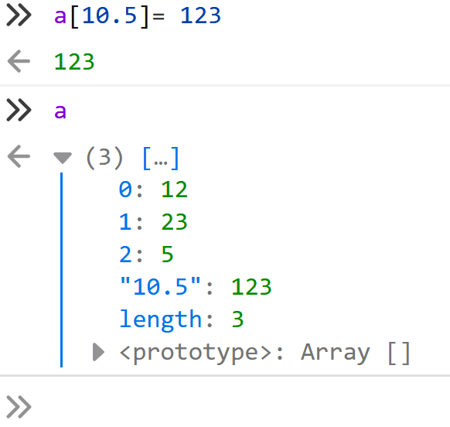
Can I have decimal or string as index???
Yes . The decimal are converted to strings and treated like properties
Since it’s a property it wont be counted in length
Object.keys(a).length

Slide 17
Iterate thro the Object
var jsonData = {"person":"me","age":"5","name":"GUVI"};
for(var i in jsonData){
var key = i;
var val = jsonData[i];
console.log(key);
console.log(val);
}

Slide 18
Iterate thro the Object array
var jsonData = [{"person":"me","age":"30"},{"person":"you","age":"25"}];
for(var i in jsonData){
var key = i;
var val = jsonData[i];
for(var j in val){
var sub_key = j;
var sub_val = val[j];
console.log(sub_key);
}
}

Slide 19
Iterators
for (let i = 0; i < arr.length; ++i)
arr.forEach((v, i) => { /* ... */ })
for (let i in arr)
for (const v of arr)

Slide 20
Iterators
for > forEach > for..of > for..in in terms of performance
https://stackoverflow.com/questions/49420891/why-should-foreach-be-preferred-over-regular-iterators

Slide 21
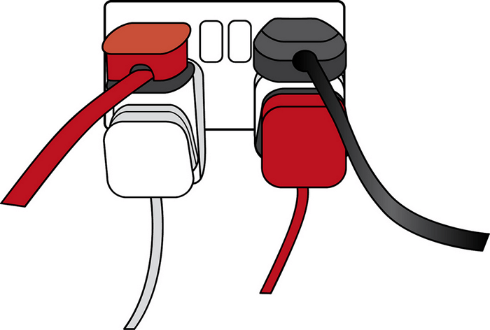
What are APIs? & JSON Objects
Application Programming Interfaces (APIs) are constructs made available in programming languages to allow developers to interact with other systems / application to get data
Sample API
https://restcountries.eu/
https://restcountries.eu/rest/v2/all
https://restcountries.eu/rest/v2/capital/tallinn

Slide 22
AJAX - Getting Data - index.html
<!DOCTYPE html>
<html lang="en">
<head>
<title>GUVI App</title>
</head>
<body>
<div id="root"></div>
<script src="scripts.js"></script>
</body>
</html>

Slide 23
scripts.js
// Create a request variable and assign a new XMLHttpRequest object to it.
var request = new XMLHttpRequest()
// Open a new connection, using the GET request on the URL endpoint
request.open('GET', 'https://restcountries.eu/rest/v2/all', true)

Slide 24
scripts.js
request.onload = function() {
// Begin accessing JSON data here
var data = JSON.parse(this.response)
console.log(data)
}
// Send request
request.send()

Slide 25
Cross-Origin Resource Sharing
Not all servers support CORS:
www.your-domain.com
www.another-domain.com
html/js/css
files
Images files
used for textures
Browser

Slide 26
Tasks - XMLHttpRequest
Open API
https://dog.ceo/api/breeds/list/all
CORS
https://api.domainsdb.info/v1/domains/search?domain=facebook&zone=com
Auth
API key
https://openweathermap.org/guide
1 hr activation
Call current weather data - By city name By city ID
OAuth
Hold it for later ☺

Slide 27
Cross-Origin Resource Sharing
Not all servers support CORS:
https://api.domainsdb.info/
Separate Server
html/js/css
files
Browser

Slide 28
fetch vs xmlhttprequest
https://developer.mozilla.org/en-US/docs/Web/API/Fetch_API
https://developers.google.com/web/updates/2015/03/introduction-to-fetch

Slide 29
Error handling
Assume your code will fail
Log errors to the server
You, not the browser, handle errors
Identify where errors might occur
Distinguish fatal versus non-fatal errors
https://www.slideshare.net/nzakas/enterprise-javascript-error-handling-presentation/25-C_ommunication_E_rrors_Invalid

Slide 30
Error handling
try {
«try_statements»
} catch (error) {
«catch_statements»
} finally {
«finally_statements»
}

Slide 31
Code error
Bug in code
Try-Catch
Catch and throw
Window.onerror
If not handled
Browser error

Slide 32
Find the fix

Slide 33
Tasks
What is the difference between window, screen, and document in Javascript?
JSON task
https://medium.com/@reach2arunprakash/guvi-zen-code-sprint-javascript-practice-problems-in-json-objects-and-list-49ac3356a8a5
Add error handling to the xmlhttprequest code
Convert the ppt into a writeup
https://www.slideshare.net/nzakas/enterprise-javascript-error-handling-presentation/25-C_ommunication_E_rrors_Invalid
Find the fix – for the error slide

Slide 34
JS
FS dev 101
Hoisting

Slide 35
Lexical Scope - Global, Local and Block scope
var x = 1;
let y = 1;
function f()
{
if (true) {
var x = 2;
let y = 2;
}
Xconsole.log(x);
// expected output: 2
console.log(y);
// expected output: 1
}
f();

Slide 36
Scope - Global, Local and Block scope
Global - Outside fun - ES5
Global variables last as long as the application is running
Function scope - function{} - ES5
Local variables last as long as a function is running
Block - {} - ES6
is limited in scope to the block in which it was defined.

Slide 37
Hoisting
Only “Variables” and “function” declarations are moved to the top of their scope before code execution.
Properties are not hoisted
Variables are hosted and not their values
var b = undefined;
console.log(b);
b = 100;
console.log(b);
console.log(b);
var b = 100;
console.log(b);

Slide 38
Hoisting twisted
function hoist() {
var b = undefined;
console.log(a,b);
window.a = 20;
b = 100;
console.log(a,b);
}
function hoist() {
console.log(a,b);
a = 20;
var b = 100;
console.log(a,b);
}
hoist();
console.log(a);
console.log(window.a);
console.log(b);

Slide 39
Hoisting twisted
function hoist() {
console.log(a,b);
a = 20;
var b = 100;
console.log(a,b);
}
// b is hoisted , a becomes window property.
Hence u will get ref err for a till the code in line3 is executed
hoist();
console.log(a);
console.log(window.a);
console.log(b);
// b is hoisted within the function scope hence you will get a ref err outside the function , a becomes window property.

Slide 40
Strict Mode
'use strict’;
// OR
"use strict";
'use strict’;
console.log(b);
var b = 100;
console.log(b);
Output: ReferenceError: b is not defined

Slide 41
ES6 - let & const
Let & const are block scoped and not function scoped
const is immutable
'use strict’;
console.log(b);
let b = 100;
console.log(b);
Output: ReferenceError: b is not defined

Slide 42
JS
FS dev 101
Object Comparison

Slide 43
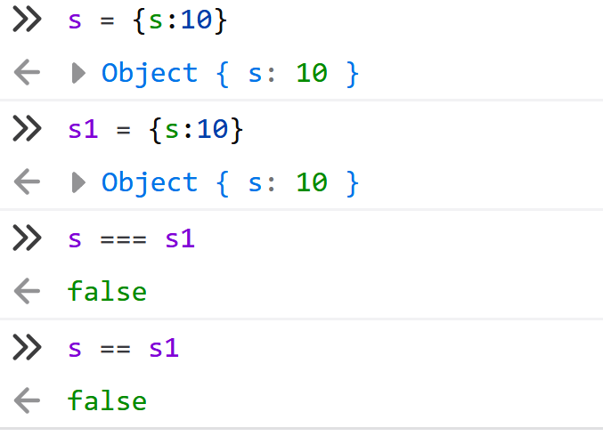
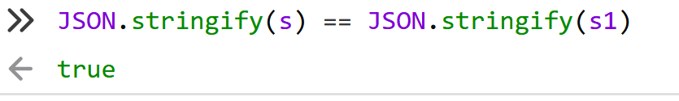
Comparision
== vs ===
2 == ‘2’ → true //checks only for value
2 === ‘2’ → false // checks for the datatype also
Comparing objects
You can’t compare objects
Stringfy and compare

Slide 44
Tasks
How to compare two JSON have the same properties without order?
var obj1 = {"name":"GUVI","class":"FS"};
var obj2 = {"class":"FS","name":"GUVI"};
Why Objects are copied & compared by reference ?

Slide 45
JS
FS dev 101
Functions

Slide 46
Basics - recap
function myfun(a=20,b) {
console.log("hi");
if(a==10)
{
return a-b; // -10
}
console.log( a + b );
return a+b;
console.log("hello");
}
What's the output??
a1 = myfun(10,20);
console.log( a1 );
b1 = myfun(20,10);
console.log( b1 );

Slide 47
var m1 = 10;
m1 = 20;
Int function f1(m1)
{
if(m1 == 10)
{
m1 = 20;
return 30;
}
if(m1 == 11)
{
return;
}
return 30;
console.log(m1);
}
m1 = f1(10);
Console.log(m1);
m1 = f1(11);
Console.log(m1);

Slide 48
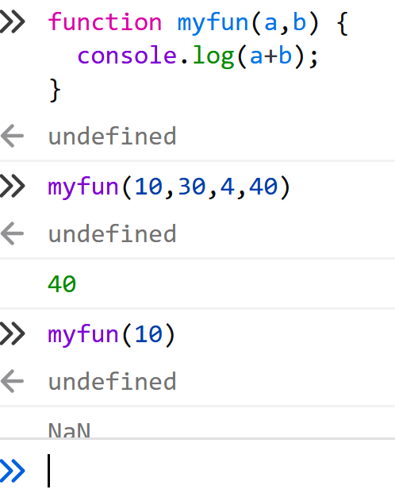
Ignores additional parameters
Fills undefined for missing params
Because of this functions overloading is not possible in JS

Slide 49
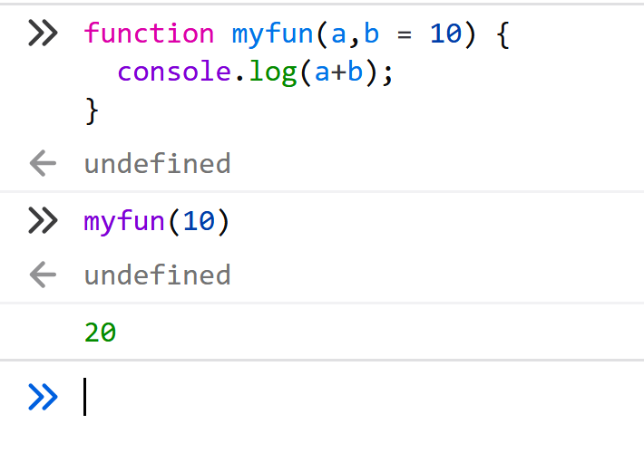
Default values

Slide 50
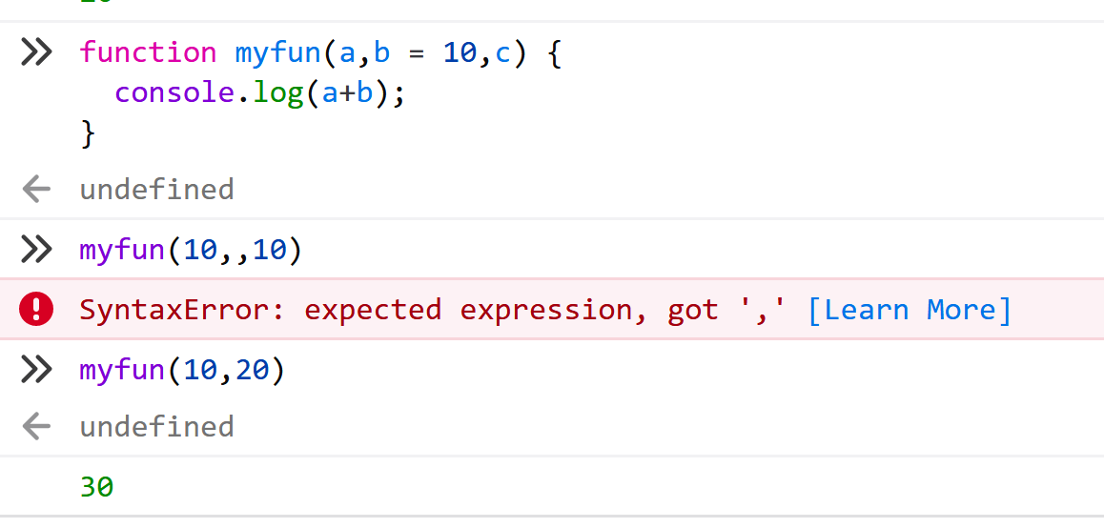

Slide 51
Anonymous functions – Function Expressions
var square = function(number) { return number * number }
square(4);
Why anonymous??
https://stackoverflow.com/questions/10273185/what-are-the-benefits-to-using-anonymous-functions-instead-of-named-functions-fo#:~:text=I%20use%20anonymous%20functions%20for,variables%20in%20the%20parent%20scopes.

Slide 52
IIFE
(function(number) { return number * number })(4)
Only Once
Module Pattern
http://benalman.com/news/2010/11/immediately-invoked-function-expression/

Slide 53
Passing function to another function
var square = function(number) { return number * number }
function newf(a){
a();
}
newf(square);

Slide 54
Task for callback
Write a function which takes 2 params
Operation
Function array
Based on the params do the operation

Slide 55
Return a function from another function
function newf(){
var inner_var = function(){
console.log(“i am inside”);
}
return inner_var;
}
Let aa = newf();
aa();

Slide 56
Mandatory Tasks - Zen tasks
Upload to git
Warmup tasks
https://medium.com/@reach2arunprakash/guvi-zen-class-javascript-warm-up-programming-problems-15973c74b87f

Slide 57
Mandatory Tasks
Do the below programs in anonymous function & IIFE
Print odd numbers in an array
Convert all the strings to title caps in a string array
Sum of all numbers in an array
Return all the prime numbers in an array
Return all the palindromes in an array
Return median of two sorted arrays of same size
Remove duplicates from an array
Rotate an array by k times and return the rotated array

Slide 58
JS
FS dev 101
ES6- Arrow Functions

Slide 59
fat arrow – Borrowed from coffee script
Source
fat arrow” functions, from CoffeeScript
Lambdas in other languages like C# or Python
What?
Skip - function, return and curly brackets
More concise syntax for writing function expressions
Why?
Used mostly in Array methods – MRF ( map , reduce , filter )
Promises and Callbacks

Slide 60
Arrow function – ES6
var square = function(number) { return number * number }
var square = (number) =>number * number
Arrow function expressions are ill suited as methods, and they cannot be used as constructors.

Slide 61
Mandatory Tasks
Watch the Array methods
https://www.youtube.com/watch?v=R8rmfD9Y5-c
Do the below programs in arrow functions
Print odd numbers in an array
Convert all the strings to title caps in a string array
Sum of all numbers in an array
Return all the prime numbers in an array
Return all the palindromes in an array

Slide 62
JS
FS dev 101
Picking ES6

Slide 63
